Slide 1
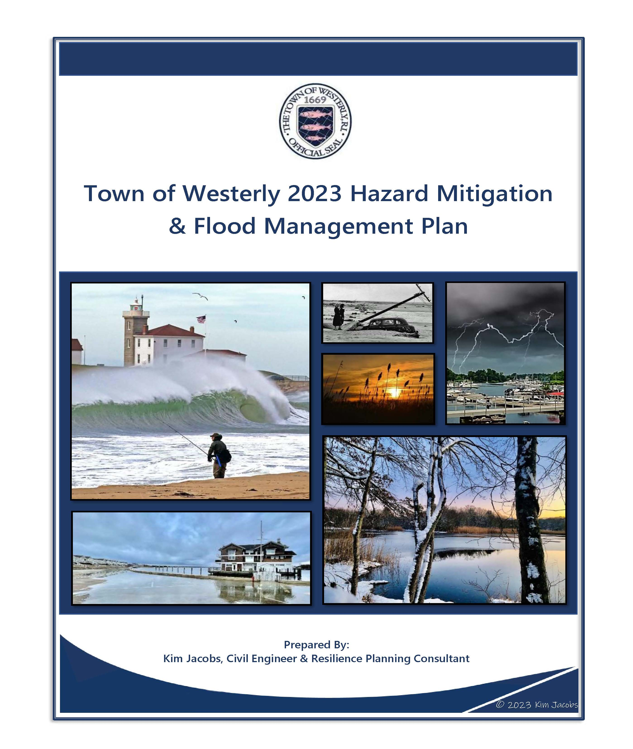

Integrating CRS into a Local Hazard Mitigation Plan – Improving the Engagement Process
A Case Study using the Town of Westerly 2023 Hazard Mitigation & Flood Management Plan
Kim Jacobs, Civil Engineer & Resilience Planning Consultant
Alyse Oziolor, Principal Planner, Town of Westerly

Slide 2
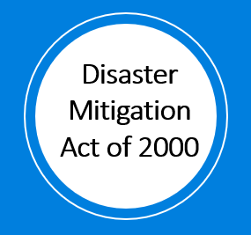
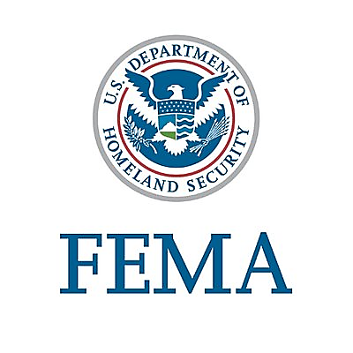
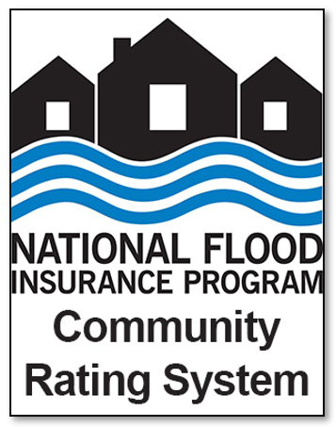
FEMA’S 2 MAJOR HAZARD MITIGATION PLANNING PROGRAMS
Local Multi-Hazard Mitigation Planning (DMA)
Floodplain Management Planning (CRS)
Requirements: 44 CFR §201.6. Local Mitigation Plans (reference: Local Mitigation Planning Policy Guide, April 2023)
Hazards Addressed: All natural hazards that can affect the community
Incentive: Prerequisite for FEMA mitigation grants
Approval: RIEMA/FEMA – all elements must be met
Objective: Reduce the threat to people and losses to property caused by natural hazard(s)
Community Centric: FEMA requirements identify planning process but communities decide local mitigation strategy
Updates: Living documents that should be reviewed and modified
(5-year required update)
Requirements: CRS Coordinator’s Manual, Activity 510 (Floodplain Management Planning)
Hazards Addressed: Flooding and flood-related hazards
(e.g., dam failure, coastal erosion)
Incentive: Reduction in flood insurance premiums
Approval: ISO – required items & minimum criteria must be met; partial credit for components awarded

Slide 3

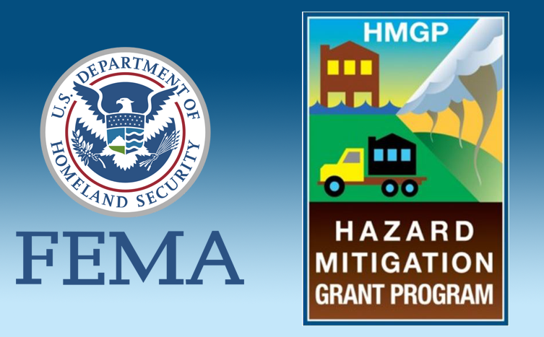
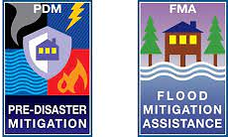
Local Multi-Hazard Mitigation Planning (DMA)
Stafford Act of 1988 (which amended previous disaster relief acts) emphasized post-disaster mitigation
Disaster Mitigation Act of 2000 amended Stafford Act and shifted emphasis to pre-disaster mitigation planning
DMA requires local Hazard Mitigation Plans to be reviewed & approved by State EMA, FEMA & local government (& updated every 5 years) as a pre-requisite for:
New Pre-Disaster Mitigation (PDM) grant program
Certain types of non-emergency disaster assistance
All 39 municipalities in RI have hazard mitigation plans (though some have expired)

Slide 4
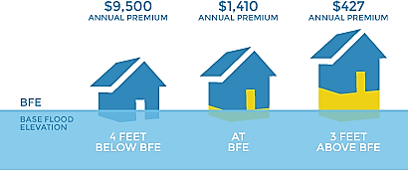
Floodplain Management Planning (CRS)
Voluntary incentive program (est. 1990) to encourage community floodplain management practices that exceed the minimum NFIP standards
3 Goals of the Program:
  Reduce & avoid flood damage to insurable property
  Strengthen & support the insurance aspects of the NFIP
  Foster comprehensive floodplain management
NFIP flood insurance premium discounts (0-45%) based on Community Rating (lower rating = bigger discount)
Annual Community Rating recertification based on points in 4 topics:
    Public Information (Elevation Certificates, maps, webpage, assistance, promotion)
    Mapping & Regulations (mapping, open space, data, regulations)
    Flood Damage Reduction (planning [Activity 510], acquisition, flood protection, drainage maintenance)
    Warning & Response (warnings, levee management, dam safety)
11 of 39 RI municipalities participate in CRS program – 1,520 communities nationwide
Source: Center for NYC Neighborhoods graphic based on rates from FEMA

Slide 5
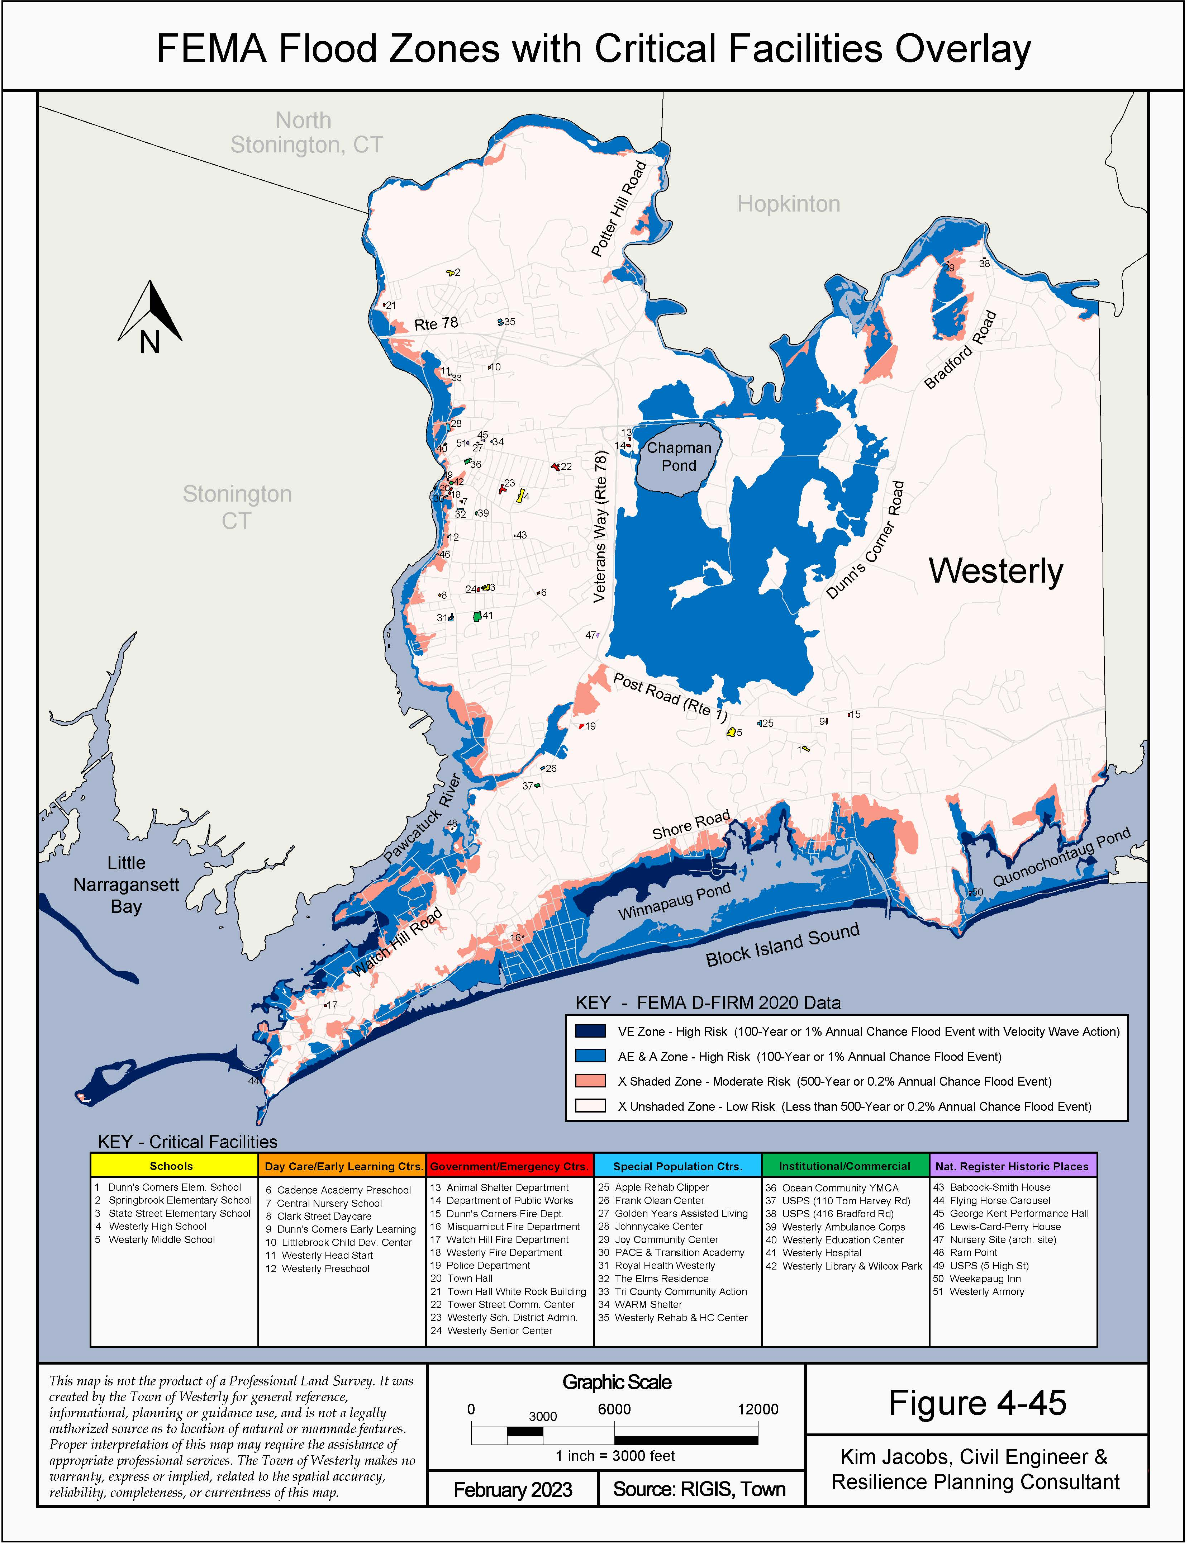
CASE STUDY: Town of Westerly 2023 Hazard Mitigation & Flood Management Plan (HM&FMP)
Notes:
Getting list of FEMA grants from Dale

Slide 6

History of Town of Westerly in DMA & CRS Program
Westerly HM&FMP
updated & expanded
2023
2003
Westerly adopts 1st HMP
Westerly HMP updated
2012
Westerly HMP updated
2018
CRS initiated
1990
DMA enacted
2000
2013
Westerly joins CRS as Class 9 Community
2018
Westerly Certified
Class 7 CRS Community
2023
First time Westerly coordinated DMA & CRS in HMP update
Kim Jacobs, Civil Engineer & Resilience Planning Consultant, recommended expanding update to create a Hazard Mitigation & Flood Management Plan (HM&FMP)
Notes:
Getting list of FEMA grants from Dale

Slide 7
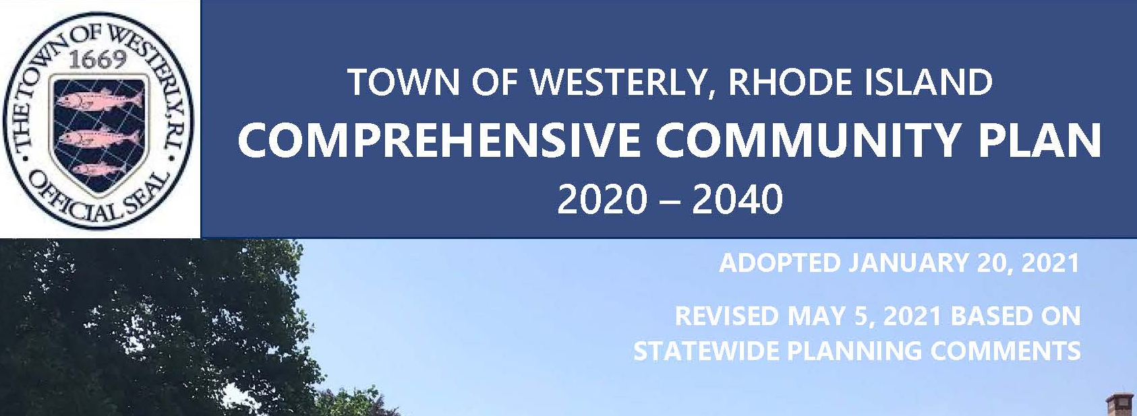
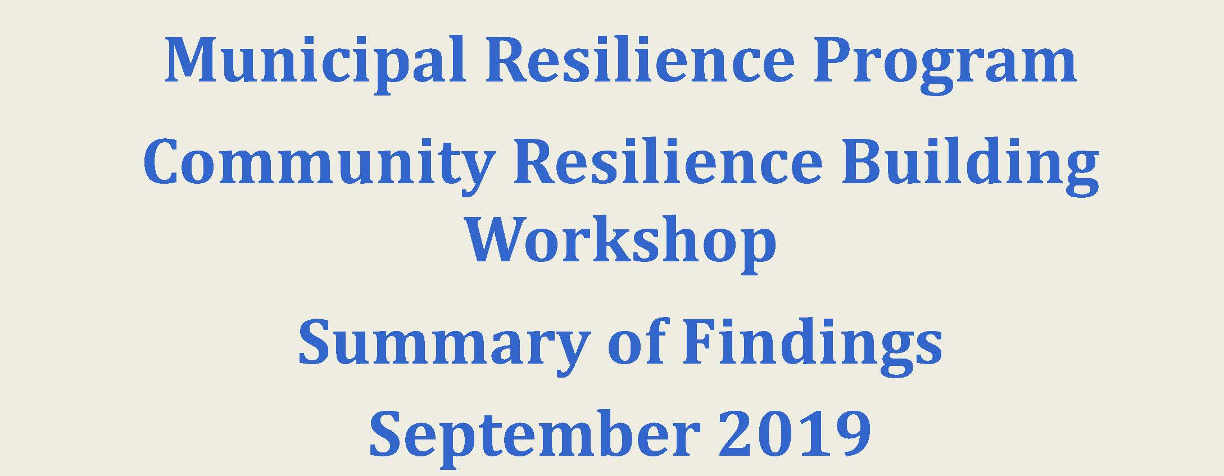







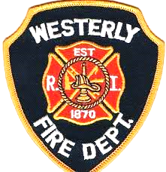



How Westerly Integrated CRS in the DMA: Steps 1, 2 & 3
Mitigation Planning Elements | CRS Activity 510 Planning Steps | Specific/Additional CRS planning criteria
A. Planning Process | 1. Organize to prepare the plan 2. Involve the public 3. Coordinate | Broader public engagement Direct contact with agencies and organizations
Built effective advisory committee
Coordinated with stakeholder agencies & organizations 13 local Town boards & commissions 37 outside agencies & organizations
Plan Integration – built upon prior public engagement Additional public engagement Public meetings & hearings Town website, press releases (newspaper & radio), flyers, library kiosk & social media posts Public opinion survey – 204 responses! Public review draft period – 3 weeks
50% Public:
Businesses, conservation, healthcare, emergency service
50%
Town Staff:
Planning, building, engineering, public works, public safety
Notes:
Waiting for completion of CRS courtesy review of 510 for credit amount

Slide 8
How Westerly Integrated CRS in the DMA: Steps 4 & 5
Mitigation Planning Elements | CRS Activity 510 Planning Steps | Specific/Additional CRS planning criteria
B. Hazard Identification and Risk Assessment | 4. Assess the hazard 5. Assess the problem | Risk assessment identifies specific items that are required or will garner more CRS points Identify how development in the floodplain has impacted the community’s vulnerability
Flood-Related Hazards Assessment Thoroughly described previous occurrences & locations known to flood including those not on the FIRM Identified how climate change will impact future flood conditions Provided a flood insurance analysis – mapped repetitive loss areas Identified impact of flooding on community assets Identified increase/decrease vulnerability due to recent development & proposed future development impacts

Slide 9
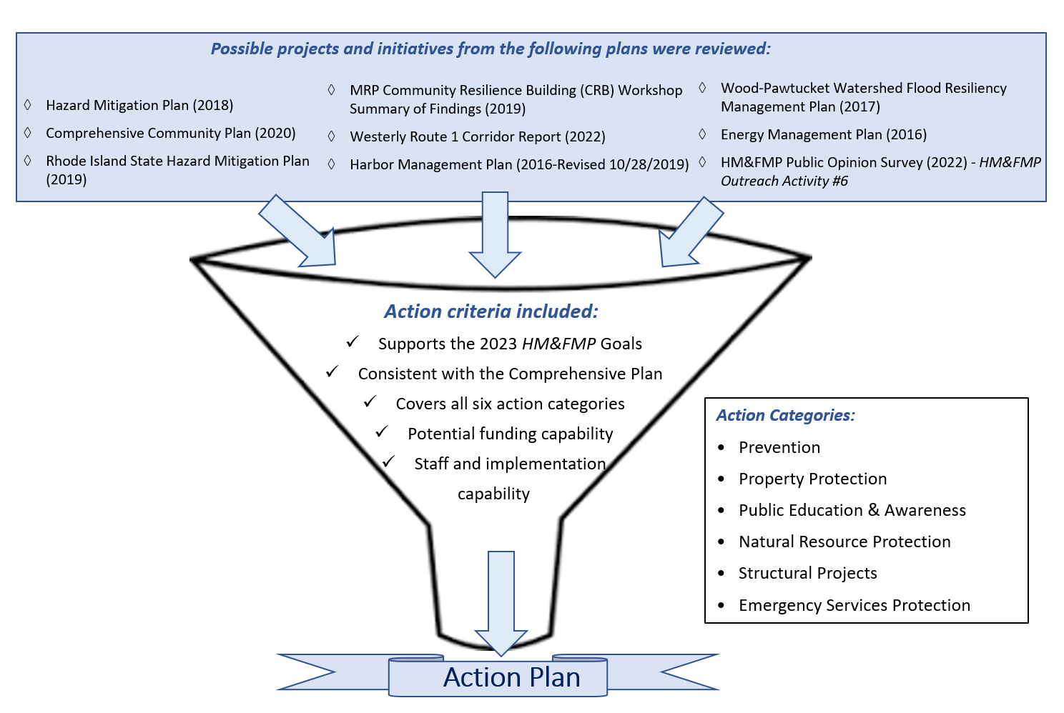
How Westerly Integrated CRS in the DMA: Steps 6, 7 & 8
Mitigation Planning Elements | CRS Activity 510 Planning Steps | Specific/Additional CRS planning criteria
C. Mitigation Strategy | 6. Set goals 7. Review possible activities 8. Draft an action plan | Review a broad spectrum of POSSIBLE mitigation activities
Integrated activities from other planning documents and identified & justified inclusion/exclusion
Included actions from all 6 flood mitigation categories
Considered prevention activities:
  Regulations: zoning ordinance, stormwater management ordinance, building codes, subdivision regulations
  Preservation of open space

Slide 10

How Westerly Integrated CRS in the DMA: Steps 9 & 10
Mitigation Planning Elements | CRS Activity 510 Planning Steps | Specific/Additional CRS planning criteria
D. Plan Update | 10. Implement, evaluate, revise 5-year update | Evaluation report to be distributed to the governing body, the media, and the public, and submitted to ISO for annual recertification
E. Plan Adoption | 9. Adopt the plan | Resolution or other formal adoption voted on by community’s governing body
Planned Semi-Annual Plan Review
Assess the progress of the goals and activities & document progress in an Evaluation Report available to the public
Local Adoption:
Town Council adopted (via resolution) the HM&FMP at the end of the Public Hearing (noting any required RIEMA/FEMA revisions would be accepted by this approval)

Slide 11
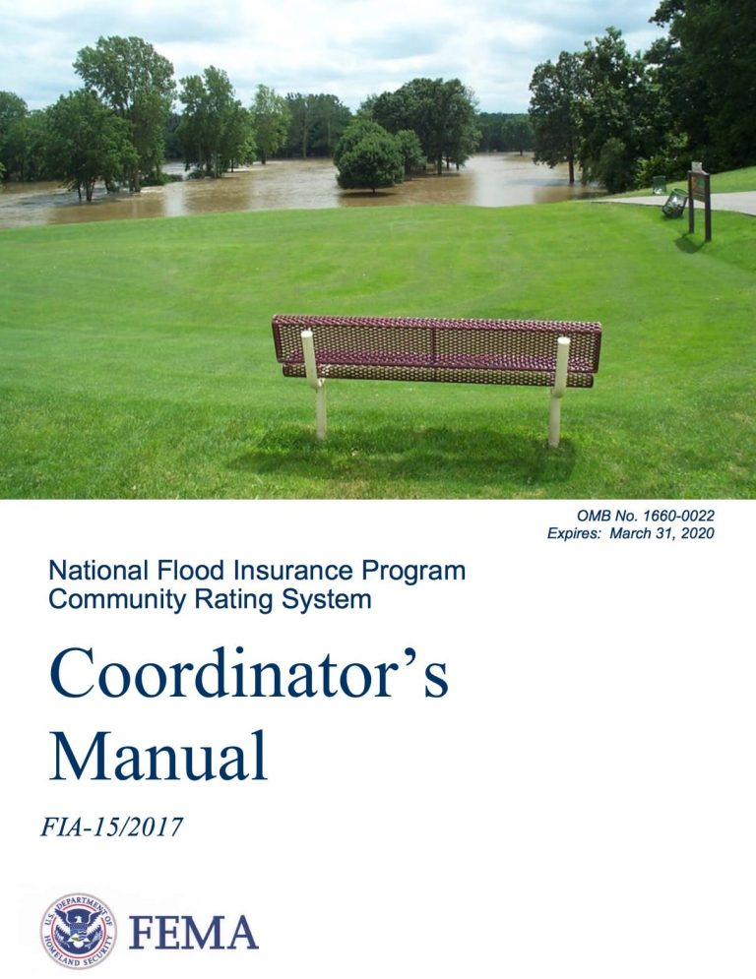
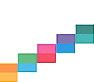
Maximizing CRS Activity 510 Credit
Familiarize yourself with the credit requirements of Activity 510
(max 382 points, average 171 points)
Include some portion of all 10 steps:
If 1 step is missing, CRS credit is limited to 50 points
If 2 steps are missing, no CRS credit
Identify what elements are required to earn credit for each step
10 steps

Slide 12

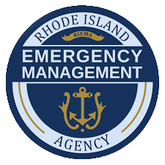

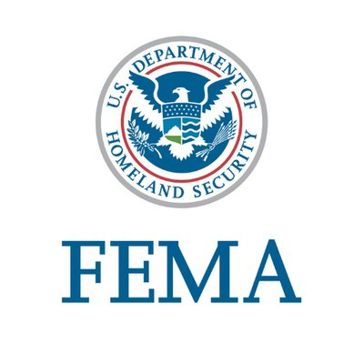
Conclusion: Integrating CRS into the DMA process adds value to the community
Better community engagement
Increase public’s hazard awareness & community support for mitigation
Build partnerships for risk reduction
Better plan integration - align risk reduction with other community objectives
Increase focus on flood hazards
Increase CRS credit & reduce flood insurance premiums
Save time, money & resources by coordinating two complementary planning processes
(Changes to the 2023 Local Mitigation Planning Policy Guide developing a combined hazard mitigation & flood management plan)
Thank you to the HM&FMP Advisory Committee, Town Council, RIEMA & FEMA & all public participants!

